Slide 1
2017 Employment Law Outlook Under the Trump Administration
John Ashby 208.344.6000
jashby@hawleytroxell.com www.hawleytroxell.com

Slide 2
Overview
Employment law under the Obama Administration
Trump philosophy and campaign promises
Trump’s tools to re-shape employment laws
Developments under the Trump Administration
Predictions for upcoming changes

Slide 3
Disclaimer

Slide 4
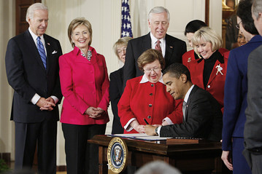
Employment law under Obama Administration
Lilly Ledbetter Fair Pay Act of 2009
Obamacare employer mandate
Increase in agency regulations and enforcement actions:
EEOC
OSHA
Wage and Hour
NLRB

Slide 5
Employment law under Obama Administration
Executive Orders directed at Federal Contractors
7 days paid sick leave
$10.20 minimum wage
LGBT Non-Discrimination
Pay Transparency
Blacklisting (self-reporting of agency determinations and civil judgments)

Slide 6
Trump Philosophy

Slide 7
Trump Philosophy

Slide 8
100-Day Action Plan
“On day one, he is going to sign a series of executive orders to …. repeal a lot of the regulations and actions that have been taken by this administration over the last eight years that have hampered both economic growth and job creation.” -- Sean Spicer, Trump's White House Press Secretary

Slide 9
Trump Toolbox
Executive Orders
Agency Appointments
EEOC, Wage and Hour, OSHA
Judicial Appointments (Justice Gorsuch)
Republican Senate/House

Slide 10
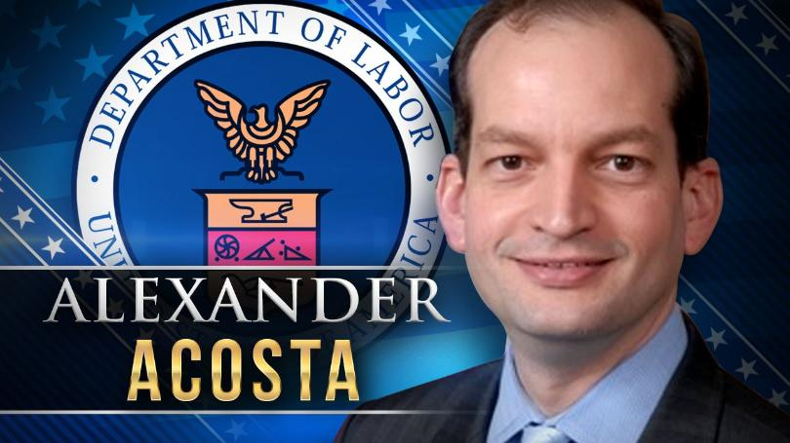
New Secretary of Labor

Slide 11
Affordable Care Act
Employer Mandate: Requires employers with 50 employees to provide health coverage to full-time employees
Individual Mandate
Subsidies
Cover children to age 26
No exclusion of pre-existing conditions

Slide 12
Affordable Care Act

Slide 13
Repeal and Replace Obamacare?
Trump promised a replacement plan that will provide "insurance for everybody" with "much lower deductibles"

Slide 14
American Health Care Act (AHCA) House bill
AHCA passed the house on May 4, 2017
Eliminates Individual Mandate
Employer Mandate for employers with 50+ employees
Technically still exists
Eliminates employer penalties retroactive to 1/1/16, rendering employer mandate toothless
Cadillac tax delayed till 2026
Notes:
Unlikely to pass Senate in current form
Cadillac tax is a 40% excise tax levied against employers who offer high-cost plans – originally scheduled to take effect in 2020. Based on premium costs. If annual premium for individual plan exceeds $10,200 for individual coverage or $27,500 for family coverage, including both employee and employer contributions, tax applies.

Slide 15
Better care reconciliation act (BCRA) Senate bill
Similar to House bill as currently proposed, in terms of employer effects
Eliminates Individual Mandate
Employer Mandate for employers with 50+ employees
Technically still exists
Eliminates employer penalties retroactive to 1/1/16, rendering employer mandate toothless
Failed to pass the Senate
“Skinny Repeal” also failed

Slide 16
Federal Minimum Wage
Trump: “The minimum wage has to go up. People are — at least $10, but it has to go up. But I think that states — federal — I think that states should really call the shot.” – July 2016
Trump Campaign Official: “On the minimum wage, Mr. Trump has voiced support for raising it to $10 at the federal level, but believes states should set the minimum wage as appropriate for their state.” – July 2016

Slide 17
FMLA
Trump Campaign Promise: “Provide 6 weeks of paid leave to new mothers before returning to work.” – Donaldjtrump.com
First speech to Congress: “My administration wants to work with members in both parties to make childcare accessible and affordable, to help ensure new parents have paid family leave…”

Slide 18
EEOC
Under the Obama Administration, the EEOC has emphasized:
Pay equality
LGBT protection
Aggressive litigation and enforcement on cutting-edge issues

Slide 19
EEOC
Trump to appoint new EEOC General Counsel
Trump to appoint EEOC commissioners as terms expire
Gradual move to a more conservative EEOC

Slide 20
Employment Immigration
Likely push for mandatory E-Verify nationwide
Increased I-9 audits
Decrease in H1-B Visas (temporary visa for high-skilled foreign workers)
“The H-1B program is neither high-skilled nor immigration: these are temporary foreign workers, imported from abroad, for the explicit purpose of substituting for American workers at lower pay…I will end forever the use of the H-1B as a cheap labor program, and institute an absolute requirement to hire American workers first for every visa and immigration program. No exceptions.”

Slide 21
DOL Overtime Regulations
New DOL regulations increase minimum salary for white collar exemptions from $23,660 per year to $47,476 per year
Enjoined by federal court just days before December 1, 2016 effective date
On appeal to the 5th Circuit
On hold pending Secretary of Labor confirmation
June 26, 2017 – DOL re-started the rulemaking process with a “Request for Information” (request for public comment)
June 30, 2017 – DOL officially dropped its defense of the new overtime regulations
New regulations to come. Likely options include:
Small business exemption
Reduce threshold or roll-back increases

Slide 22
Working Families Flexibility Act of 2017 (H.R. 1180)
FLSA requires payment of overtime (1.5x regular rate) for every hour worked over 40 per workweek
FLSA does not allow “Compensatory Time” other than for some government employees
Working Families Flexibility Act passed a House vote on May 2, 2017
Must pass a Senate vote to become law

Slide 23
What would the Working Families Flexibility Act Do?
Employers may offer employees 1.5 hours of compensatory time in lieu of overtime for hours over 40 per week
Employee can choose overtime (1.5 x $) or compensatory time (1.5 x hours)
Employees must be permitted to use the compensatory time within a “reasonable period” after making a request to use the time, as long as it would “not unduly disrupt the operations of the employer”
Example: Employee who works 50 hours in one week earns 15 hours of compensatory time. That employee can use compensatory time to work only 25 hours during a week in the future

Slide 24
Working families Flexibility Act Rules
Voluntary: Employer cannot coerce employees to select compensatory time instead of overtime
Employee must agree in writing
Compensatory time capped at 160 hours per year
Accrued but unused compensatory time must be cashed out (1) by January 31st of the next year or (2) upon termination of employment
Employee can elect to cash out compensatory time upon 30 days notice
Employer can elect to cash out accrued compensatory time over 80 hours

Slide 25
Questions? John Ashby jashby@hawleytroxell.com 208.344.6000 www.hawleytroxell.com

