Slide 1
REBOOTING HARASSMENT PREVENTION
Presented to:
Snake River Chapter of SHRM
June 8, 2017
Bobbi K. Dominick, JD, SPHR, SHRM-SCP
Gjording Fouser, PLLC

Slide 2
What Do We Mean “Reboot”?
Notes:
Reboot means: to make a change in (something) in order to establish a new beginning
In harassment prevention, it means:
look closely at efforts to prevent harassment,
Begin anew to understand what really works in prevention

Slide 3
Why do we need to reboot?

Slide 4
EEOC 2016 Report: Select Task Force on the Study of Harassment in the Workplace
Stop focusing on legal liability
Stop focusing merely on “compliance” mentality
Focus on what really works in prevention
“Preventing harassment from occurring in the first place is far preferable to remedying its consequences.”

Slide 5
In the 1980’s, it appeared possible to curtail and even eliminate harassment simply by enacting laws and developing policies. Few foresaw that laws could be “bent,” if not broken; that rigorous legal and grievance processes might be cited as deterrents to reportage; that approaches that worked well in some organizational settings would fail in others; that perceptions of what constitutes harassing behaviors could be influenced by individual, cultural, and generational, as well as gender, variables—in short, that understanding and preventing sexual harassment would be an ongoing, never-quite-final endeavor.
Dziech, Billie Wright & Hawkins, Michael W. Sexual Harassment in Higher Education: Reflections and New Perspectives, p. 32 , Garland Publishing (1998)

Slide 6
Systems thinking
Culture
Leadership & HR roles
Understanding psychological antecedents & responses
Notes:
Requires an understanding of organizational leadership, organizational culture and systems
Requires partnership between leadership and HR professionals
Understanding that fear of complaints and impulse towards protection against complaints is not in best interests of the client

Slide 7
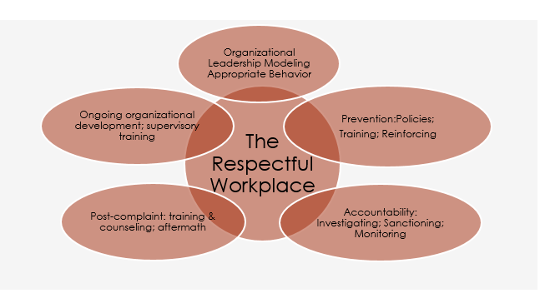
The Big Picture
Notes:
Creating a respectful workplace is more than just having a policy in place. It requires everyone, at all levels of the organization, working together to make our workplaces better. Preventing harassment is one aspect of a respectful workplace, by having policies and this type of training, but it also means that there is accountability when harassment occurs, that leaders, supervisors and employees all have a roles to play, and that everyone understands and models appropriate behavior.

Slide 8
Important to Note
Legal standard: absolute minimum
Most organizations: workplace conduct norms that go beyond the minimum
Organization’s values drive behavioral rules as well.
Leadership=culture=behavior

Slide 9
Some things to think about
How does leadership of the organization communicate the organizational value of prevention?
How does the organizational culture support prevention?
Is the workforce more vulnerable to harassing behaviors, requiring more effort at prevention?

Slide 10
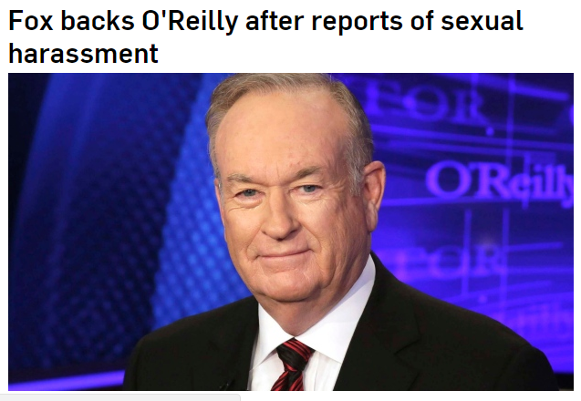
Some things to think about

Slide 11
More vulnerable workforces
Homogenous workforces (a lack of diversity in the workplace.)
Minority don’t conform to unspoken workplace norms (ex: male behaves “effeminately”)
Cultural and language differences.
Coarsened social discourse outside the workplace (9/11 or recent election campaign).
Many young workers not aware of appropriate behavior.
High value employees like top producers, more leeway for bad behavior.
Significant power disparities, low status workers.
Customer service or client satisfaction reliant, livelihood depends on tolerating bad behavior.
Workplaces with monotonous tasks.
Isolated workplaces.
Tolerance of alcohol consumption.
Decentralized workplaces where leadership is attenuated.

Slide 12
Rebooting requires
A proactive approach
A multifaceted approach
A close examination: what works in prevention, and what we can improve
Not just sexual harassment, but harassment based on all protected classes

Slide 13
The Big Picture
LEADERSHIP
CULTURE
Notes:
Creating a respectful workplace is more than just having a policy in place. It requires everyone, at all levels of the organization, working together to make our workplaces better. Preventing harassment is one aspect of a respectful workplace, by having policies and this type of training, but it also means that there is accountability when harassment occurs, that leaders, supervisors and employees all have a roles to play, and that everyone understands and models appropriate behavior.
Leadership: Behaviors that encourage harassment rather than prevent it
Tolerance of offensive behaviors or materials
Leaders who are permissive (ignore policies or look the other way, or fail to address the behavior)
Ineffective policies, or policies not widely known, distributed, talked about, and reinforced
Nonexistent or ineffective training, not supported by leadership
Leader models harassing behaviors
Allowing perception of retaliation

Slide 14
Leadership=Culture
EEOC 2016: “…workplace culture has the greatest impact on allowing harassment to flourish, or conversely, in preventing harassment. …leadership and commitment to a diverse, inclusive and respectful workplace in which harassment is simply not acceptable is paramount. …Second, …an organization must have systems in place that hold employees accountable for this expectation…An organization’s culture is set by the values of the organization….”

Slide 15
HR: Leadership & Contribution to Prevention
Notes:
Over the next few months, I began to meet more women engineers in the company. As I got to know them, and heard their stories, I was surprised that some of them had stories similar to my own. Some of the women even had stories about reporting the exact same manager I had reported, and had reported inappropriate interactions with him long before I had even joined the company. It became obvious that both HR and management had been lying about this being "his first offense", and it certainly wasn't his last. Within a few months, he was reported once again for inappropriate behavior, and those who reported him were told it was still his "first offense". The situation was escalated as far up the chain as it could be escalated, and still nothing was done.
Myself and a few of the women who had reported him in the past decided to all schedule meetings with HR to insist that something be done. In my meeting, the rep I spoke with told me that he had never been reported before, he had only ever committed one offense (in his chats with me), and that none of the other women who they met with had anything bad to say about him, so no further action could or would be taken. It was such a blatant lie that there was really nothing I could do. There was nothing any of us could do. We all gave up on Uber HR and our managers after that. Eventually he "left" the company. I don't know what he did that finally convinced them to fire him.

Slide 16
The Big Picture
TRAINING
Notes:
Creating a respectful workplace is more than just having a policy in place. It requires everyone, at all levels of the organization, working together to make our workplaces better. Preventing harassment is one aspect of a respectful workplace, by having policies and this type of training, but it also means that there is accountability when harassment occurs, that leaders, supervisors and employees all have a roles to play, and that everyone understands and models appropriate behavior.

Slide 17
Training
Compliance vs. behavioral change
Supported by leadership; reinforce policies
Recognition outcomes
Understanding reactions; reducing victim blaming to encourage reporting
Understanding harm & impact
Fit within cultural norms & become part of culture of ethical behavior
EEOC: Live, interactive training
Multiple methods (lecture, behavior modeling, role play, case studies, etc.)
Acknowledges factors such as implicit bias, attitudes
All types of harassment
Bystander intervention
Sustained, effective training
Notes:
Sexual harassment training at Fox News

Slide 18
Common Psychological Responses to Harassment (Coping)
Avoidance
Denial (relabeling, tolerating, detaching, self-blame)
Minimizing
Assertion
Advocacy or seeking help
Social coping

Slide 20
Why do employees hesitate to report discrimination, workplace harassment and sexual harassment?
Fear of losing their job
Fear of retaliation
Fear of getting someone into trouble
Fear of disrupting the workplace
Fear of being accused of having no sense of humor, or not being a team player
Fear of being embarrassed
Fear of feeling impotent or not valued
Fear of not being believed.

Slide 21
The Big Picture
POLICIES
Notes:
Creating a respectful workplace is more than just having a policy in place. It requires everyone, at all levels of the organization, working together to make our workplaces better. Preventing harassment is one aspect of a respectful workplace, by having policies and this type of training, but it also means that there is accountability when harassment occurs, that leaders, supervisors and employees all have a roles to play, and that everyone understands and models appropriate behavior.

Slide 22
Policies
EEOC:
Clear explanation of prohibited conduct
Assurance of nonretaliation
Clear complaint process
Assurance of confidentiality
Prompt, thorough, impartial investigations
Assurance of immediate and appropriate corrective action

Slide 23
Policies
Highly publicized-wide dissemination
Highly regarded by leadership
Sets organizational expectations
Establishes a culture of respect
Defines all types of discrimination and harassment
Sets framework for accountability for those who harass and for supervisors

Slide 24
The Big Picture

Slide 25
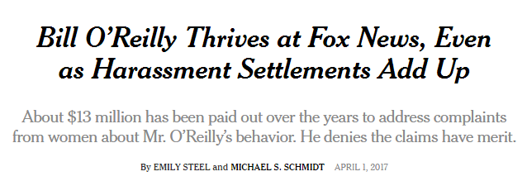
Accountability
INVESTIGATIONS
ACCOUNTABILITY

Slide 26
The Big Picture
NO. 1 CATEGORY: RETALIATION
Notes:
Creating a respectful workplace is more than just having a policy in place. It requires everyone, at all levels of the organization, working together to make our workplaces better. Preventing harassment is one aspect of a respectful workplace, by having policies and this type of training, but it also means that there is accountability when harassment occurs, that leaders, supervisors and employees all have a roles to play, and that everyone understands and models appropriate behavior.

Slide 27
Aftermath
Individual Training
Group Work
Nonretaliation

Slide 28
The Big Picture
Notes:
Creating a respectful workplace is more than just having a policy in place. It requires everyone, at all levels of the organization, working together to make our workplaces better. Preventing harassment is one aspect of a respectful workplace, by having policies and this type of training, but it also means that there is accountability when harassment occurs, that leaders, supervisors and employees all have a roles to play, and that everyone understands and models appropriate behavior.

Slide 29
Ongoing Development
Supervisory training on intervention
Leadership development
Communication strategies
Culture development
Focus on respect in the workplace
Focus on diversity and inclusion
Leadership investment

Slide 30
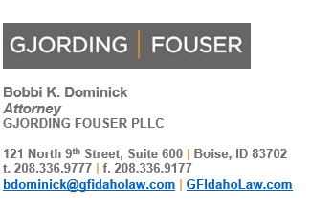
Need more? Contact:

Slide 31
Appendix: EEOC Recommendations

Slide 32
Recommendations Regarding Workplace Leadership and Accountability
Employers should foster an organizational culture in which harassment is not tolerated, and in which respect and civility are promoted. Employers should communicate and model a consistent commitment to that goal.
Employers should assess their workplaces for the risk factors associated with harassment and explore ideas for minimizing those risks.
Employers should conduct climate surveys to assess the extent to which harassment is a problem in their organization.
Employers should devote sufficient resources to harassment prevention efforts, both to ensure that such efforts are effective, and to reinforce the credibility of leadership's commitment to creating a workplace free of harassment.
Employers should ensure that where harassment is found to have occurred, discipline is prompt and proportionate to the severity of the infraction. In addition, employers should ensure that where harassment is found to have occurred, discipline is consistent, and does not give (or create the appearance of) undue favor to any particular employee.
Employers should hold mid-level managers and front-line supervisors accountable for preventing and/or responding to workplace harassment, including through the use of metrics and performance reviews.
If employers have a diversity and inclusion strategy and budget, harassment prevention should be an integral part of that strategy.

Slide 33
Recommendations Regarding Harassment Prevention Policies and Procedures
Employers should adopt and maintain a comprehensive anti-harassment policy (which prohibits harassment based on any protected characteristic, and which includes social media considerations) and should establish procedures consistent with the principles discussed in this report.
Employers should ensure that the anti-harassment policy, and in particular details about how to complain of harassment and how to report observed harassment, are communicated frequently to employees, in a variety of forms and methods.
Employers should offer reporting procedures that are multi-faceted, offering a range of methods, multiple points-of-contact, and geographic and organizational diversity where possible, for an employee to report harassment.
Employers should be alert for any possibility of retaliation against an employee who reports harassment and should take steps to ensure that such retaliation does not occur.
Employers should periodically "test" their reporting system to determine how well the system is working.
Employers should devote sufficient resources so that workplace investigations are prompt, objective, and thorough. Investigations should be kept as confidential as possible, recognizing that complete confidentiality or anonymity will not always be attainable.
Employers should ensure that where harassment is found to have occurred, discipline is prompt and proportionate to the behavior(s) at issue and the severity of the infraction. Employers should ensure that discipline is consistent, and does not give (or create the appearance of) undue favor to any particular employee.
In unionized workplaces, the labor union should ensure that its own policy and reporting system meet the principles outlined in this section.

Slide 34
Recommendations Regarding Anti-Harassment Compliance Training
Employers should offer, on a regular basis and in a universal manner, compliance trainings that include the content and follow the structural principles described in this report, and which are offered on a dynamic and repeated basis to all employees.
Employers should dedicate sufficient resources to train middle-management and first-line supervisors on how to respond effectively to harassment that they observe, that is reported to them, or of which they have knowledge or information - even before such harassment reaches a legally-actionable level.

Slide 35
Recommendations Regarding Workplace Civility and Bystander Intervention Training
Employers should consider including workplace civility training and bystander intervention training as part of a holistic harassment prevention program.

